Slide 1
Chapter - 3 Error and Exception handling

Slide 2
Error/bug
Error: unexpected output
Debugging: process of finding and removing errors from program is
Compile time error(Syntax)
Runtime error
Logical error
Error Types

Slide 3
A. Syntax (design, compile) error
Occurs due to the violation of one or more grammar rules (due syntactical errors)
Compiler detects syntax errors at the time of compilation or translation
csc compiler
These errors are easy to locate and remove because compiler specifies the location and type of error.

Slide 4
Cont…
Syntax/Design-Time errors are easy enough to spot because the C# software will underline them with a wavy colored line.
Three different colored lines are displayed:
Blue,
Red and
Green

Slide 5

Cont…
Blue wavy lines: are known as Edit and Continue issues, meaning that you can make change to your code without having to stop the program altogether.
This is an Edit and Continue Error. It’s been flagged because the form doesn’t have a control called textBox2 – it’s called textBox1. We can simply delete the 2 and replace it with a 1.

Slide 6
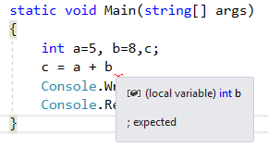
Cont…
Red wavy lines: are Syntax errors, such as
Missing semicolon at the end of a line, or
Missing curly bracket in an IF Statement … etc.
The program having syntax errors can not be compiled or translated

Slide 7
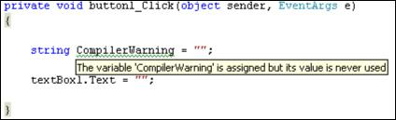
Cont…
Green wavy lines: are Compiler Warnings.
Gets when C# spots something that could potentially cause a problem, Like declaring a variable that’s never used.

Slide 8
B. Runtime error
It occurs due to performing an illegal operation.
Computer detects this error at the time of at the time of execution
Running program is stopped or crashed and a diagnostic message is displayed on the screen causing that error.

Slide 9
Cont…
Run time errors occurs due to various reasons
Wrong implementation of logic
Wrong input supplied
Missing required resources

Slide 10
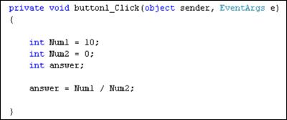
Wrong implementation of logic
Compiler will not check the logic error
Example: A number divided by zero
The program itself reports no problems when it is started up, and there are no colored wavy lines

Slide 11
Wrong input supplied
Writing the program that ask user to inter integer value but unfortunately user inter character, double, float or string value

Slide 12
Missing required resources
Trying to write to a file on the hard disk which has is deleted
Network problem or server shut down
Bank which did not updating balance
Example: - Accessing memory that is not available

Slide 13
C. Logical error
Comparatively difficult to detect this error
Programmers finds this error by the whole program statement by statement.
Logic errors are ones where you don’t get the result you were expecting.
You won’t see any colored wavy lines, and the program generally won’t “bug out” on you.
Running program does not stop or crash but the output is generated
In other words, you’ve made an error in your programming logic.

Slide 14
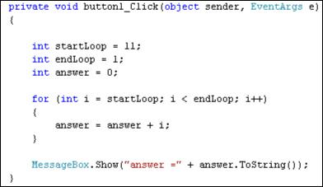
Cont…
Example:
loop never executes.

Slide 15
Who is the responsible for such problems ?

Slide 16
Exception
An exception is a problem that arises during the execution of a program
Exception handling is a mechanism to handle runtime errors so that normal flow of the application can be maintained,
E.g. Handle an attempt to divide by zero.

Slide 17
Causes of Exceptions
An exception can occur for many different reasons such as.
Due to invalid input user data.
Due to file that cannot be found.
Due to network connection lost in the middle of communications
Due to run out of memory.

Slide 18
Advantage of Exception Handling
The core advantage of exception handling is to maintain the normal flow of the application.
main function()
{
statement 1;
statement 2;
statement 3; // Error or Exception occurs
statement 4;
statement 5
}

Slide 19
Exception Classes in C#
C# exceptions are represented by classes.
The exception classes in C# are mainly directly or indirectly derived from the System.Exception class.
Some of the exception classes derived from the System.Exception class are:
System.ApplicationException and
System.SystemException classes.

Slide 20
Cont…
The System.ApplicationException class supports exceptions generated by application programs. Hence the exceptions defined by the programmers should derive from this class.
The System.SystemException class is the base class for all predefined system exception
The following table provides some of the predefined exception classes derived from the Sytem.SystemException class

Slide 21
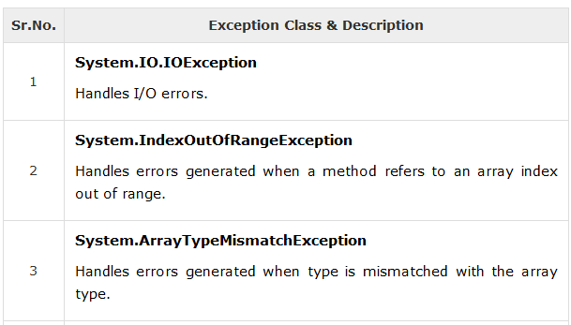
Cont…

Slide 22
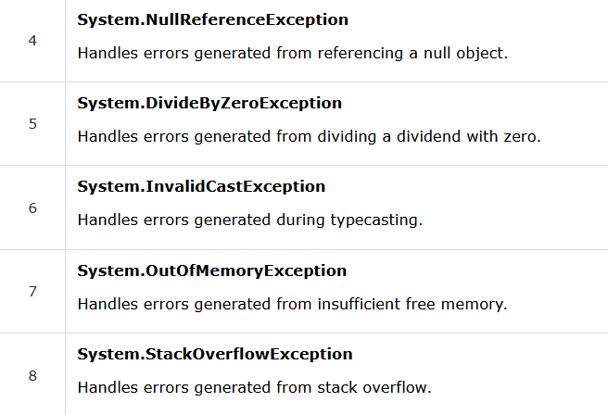
Cont…

Slide 23
Handling Exceptions
Exceptions handling provide a way to transfer control from one part of a program to another.
C# exception handling is built upon four keywords: try, catch, finally and throw.

Slide 24
Cont…
try − A try block identifies a block of code for which particular exceptions is activated. It is followed by one or more catch blocks.
catch − A program catches an exception with an exception handler. The catch keyword indicates the catching of an exception.
finally − The finally block is used to execute a given set of statements, whether an exception is thrown or not thrown.
For example, if you open a file, it must be closed whether an exception is raised or not.
throw − A program throws an exception when a problem shows up. This is done using a throw keyword

Slide 25
Cont…
A try/catch block is placed around the code that might generate an exception.
Code within a try/catch block is referred to as protected code.

Slide 26
Syntax:
try {
// statements causing exception
} catch( ExceptionName e1 ) { // error handling code }
catch( ExceptionName e2 ) { // error handling code }
catch( ExceptionName eN ) { // error handling code }
finally { // statements to be executed }

Slide 27
Example-1
static void Main(string[] args)
{
int num1, num2, result;
num1 = 6;
num2 = 2;
try
{
result = num1 / num2;
Console.WriteLine("Result=" + result);
}catch (DivideByZeroException e){ Console.WriteLine("Exception caught: {0}",e.Message); }
// OR
catch (DivideByZeroException e){ Console.WriteLine("Divide By Zero Error"); }
Console.WriteLine("We Are Happy");
Console.WriteLine("Today it's lab 3");
}

Slide 28
Example-2 – Multiple Catch
static void Main(string[] args) {
int[] n = new int[5];
int i, sum = 0;
Console.WriteLine("please Enter 5 numbers");
for (i = 0; i < 5; i++)
{
try {
n[i] = int.Parse(Console.ReadLine());
sum += n[i];
}
catch (DivideByZeroException e) { Console.WriteLine("Exception caught: {0}", e.Message); }
catch (IndexOutOfRangeException e) { Console.WriteLine("Exception caught: {0}", e.Message); }
}
Console.WriteLine("SUM=" + sum);
Console.WriteLine("We Are Happy");
Console.WriteLine("Today it's lab 3");
}

Slide 29
Finally
Used to execute a given set of statements, whether an exception is thrown or not thrown.
finally block is a block that is used to execute important code such as closing connection, stream etc.
Comes after try or catch block

Slide 30
Example-3
static void Main(string[] args)
{
int num1, num2, result;
num1 = 6;
num2 = 0;
try
{
result = num1 / num2;
Console.WriteLine("Result =" + result);
} catch (IndexOutOfRangeException e) { Console.WriteLine("Exception caught: {0}", e.Message); }
finally
{
Console.WriteLine("ALWAYS ECECUTED");
}
Console.WriteLine("We Are Happy");
Console.WriteLine("Today it's lab 3");
}

Slide 31
Cont…
For each try block there can be zero or more catch blocks, but only one finally block.
Reading assignment
Throw
C# Classes
C# Methods
C# Structure
C# Inheritance
C# Polymorphism
C# Encapsulation
C# Abstraction

Slide 32
The end!

